Slide 1
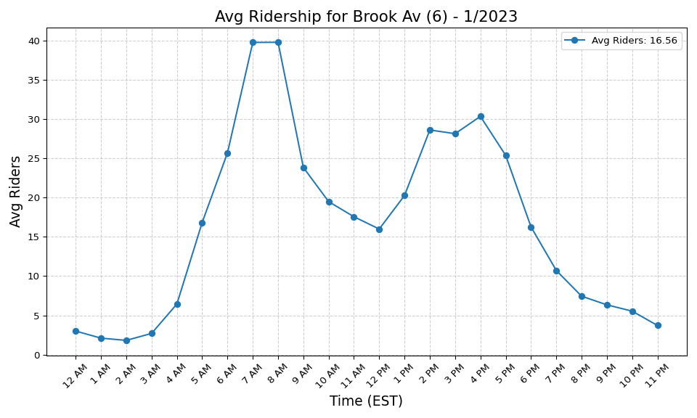
Brook Av (6) - 1/2023

Slide 2
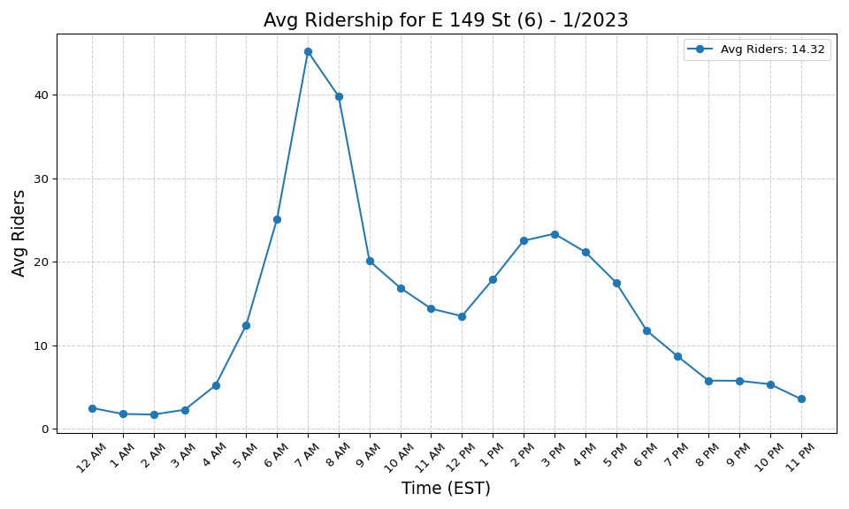
E 149 St (6) - 1/2023

Slide 3
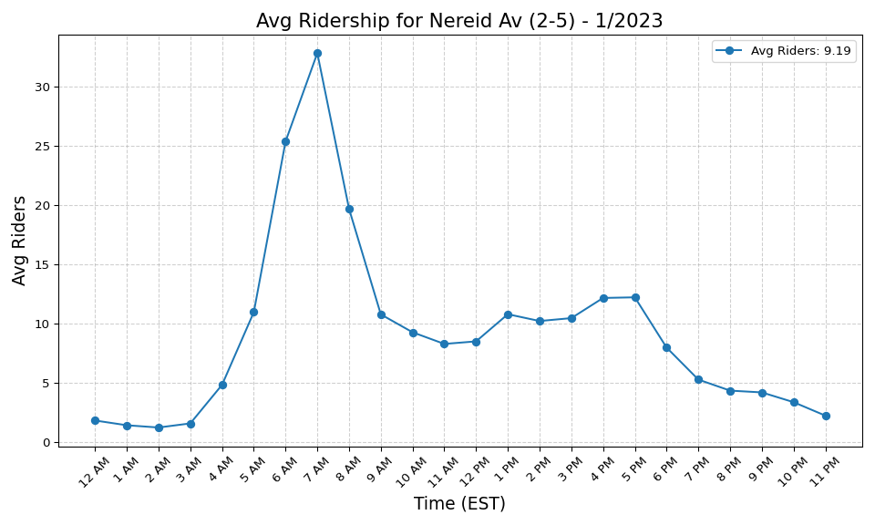
Nereid Av (2-5) - 1/2023

Slide 4

E 180 St (2-5) - 1/2023

Slide 5
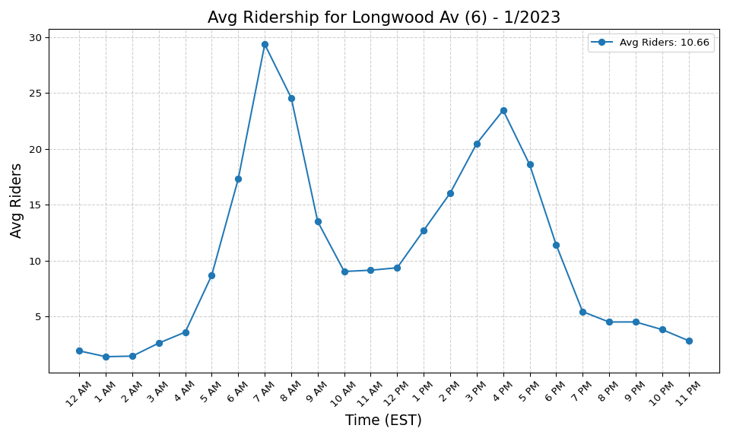
Longwood Av (6) - 1/2023

Slide 6
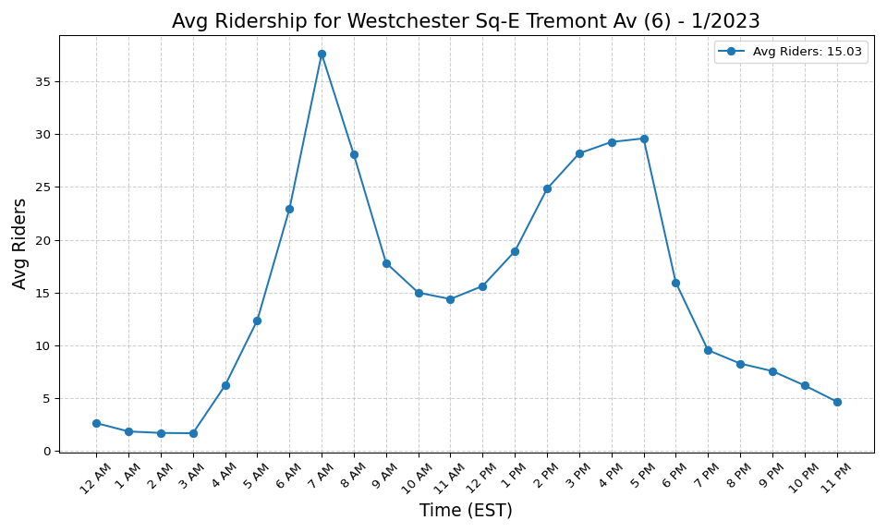
Westchester Sq-E Tremont Av (6) - 1/2023

Slide 7
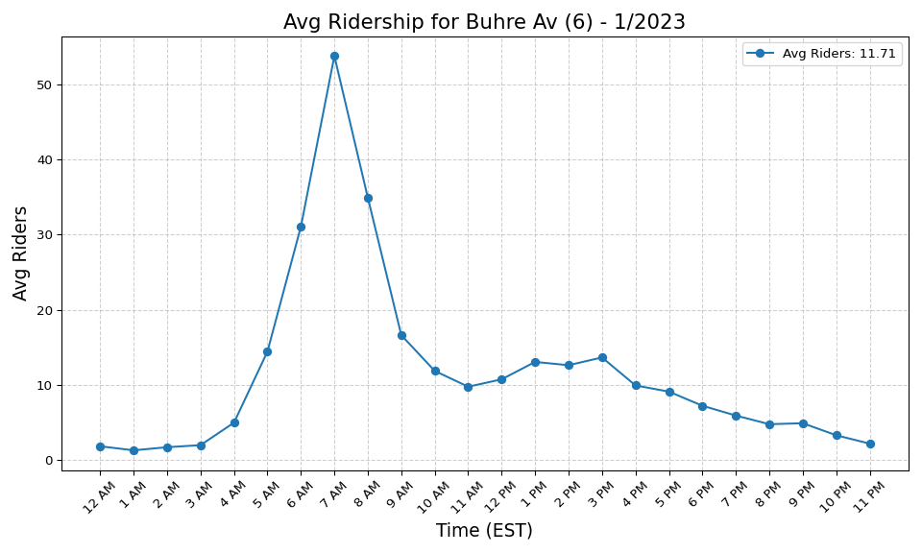
Buhre Av (6) - 1/2023

Slide 8
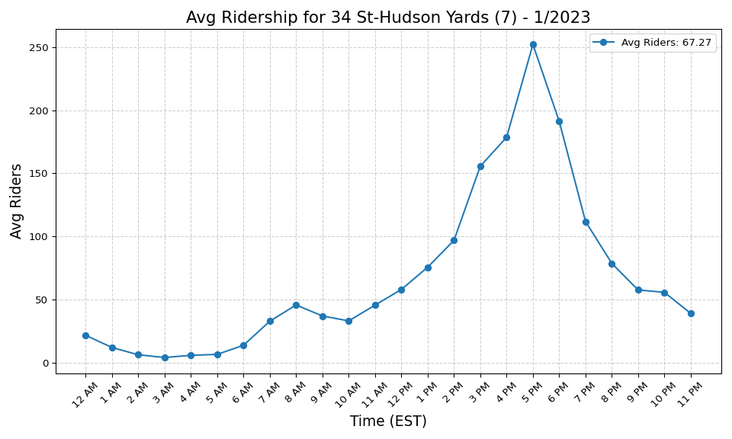
34 St-Hudson Yards (7) - 1/2023

Slide 9
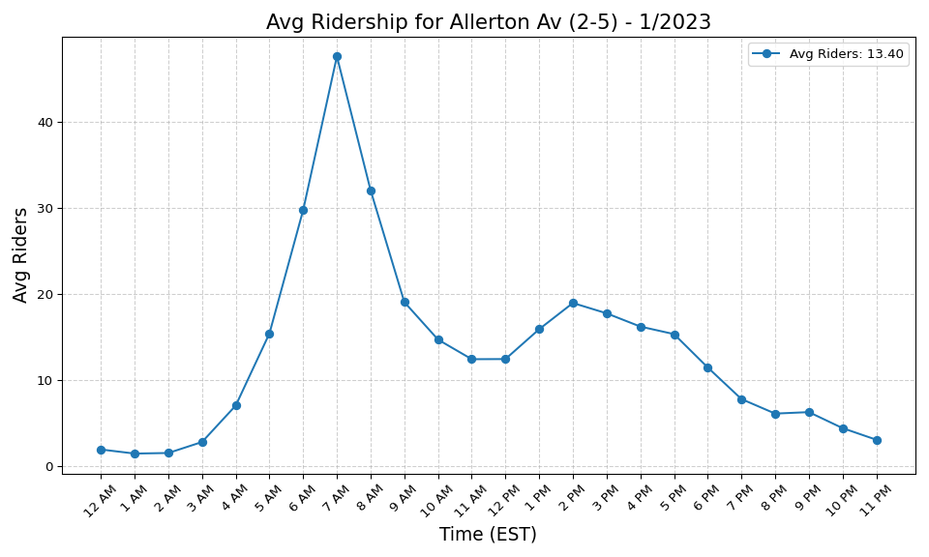
Allerton Av (2-5) - 1/2023

Slide 10
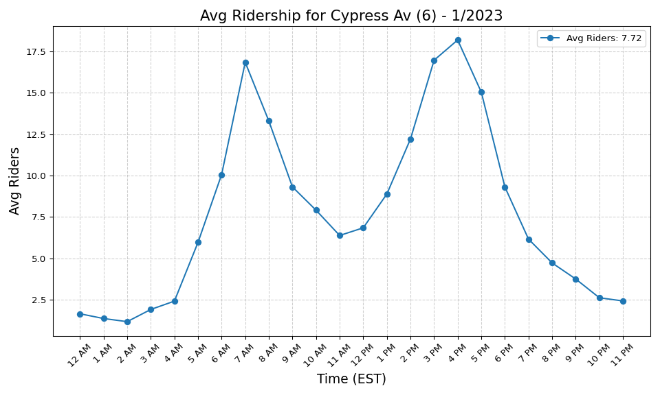
Cypress Av (6) - 1/2023

Slide 11
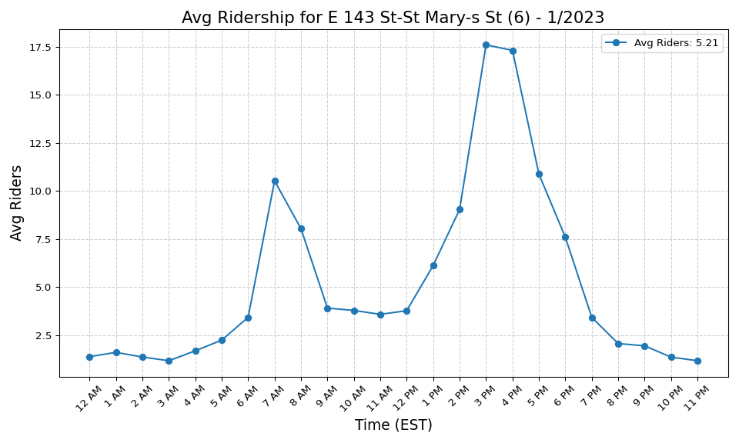
E 143 St-St Mary-s St (6) - 1/2023

Slide 12
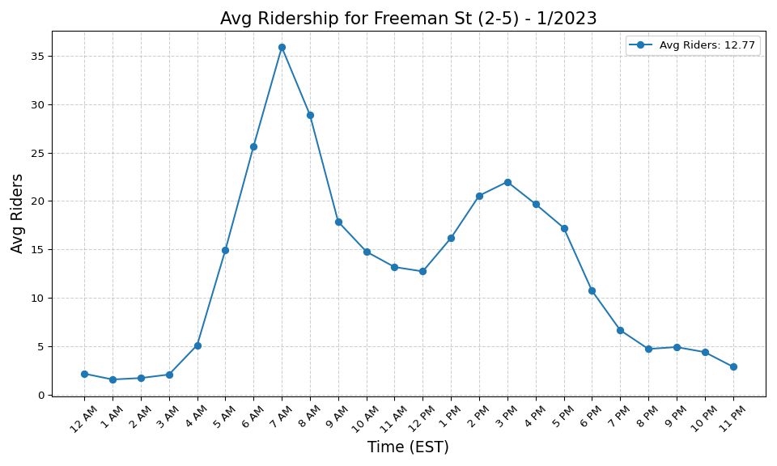
Freeman St (2-5) - 1/2023

Slide 13
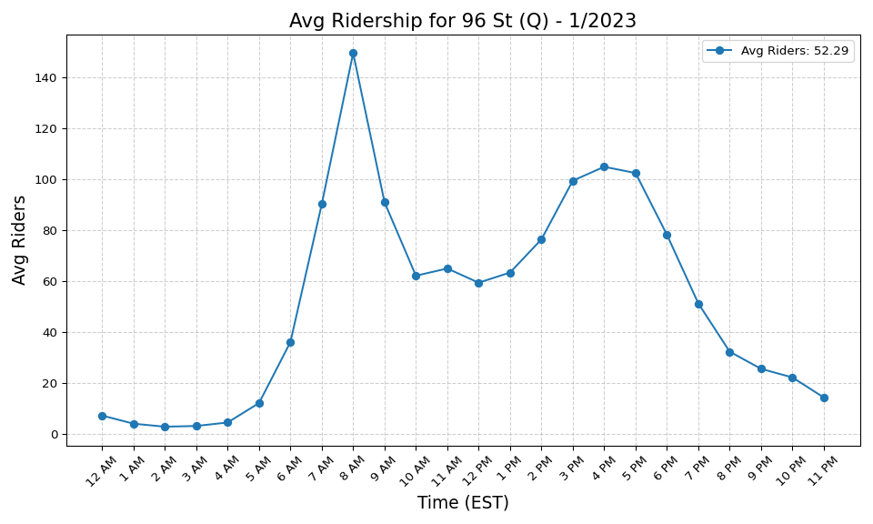
96 St (Q) - 1/2023

Slide 14
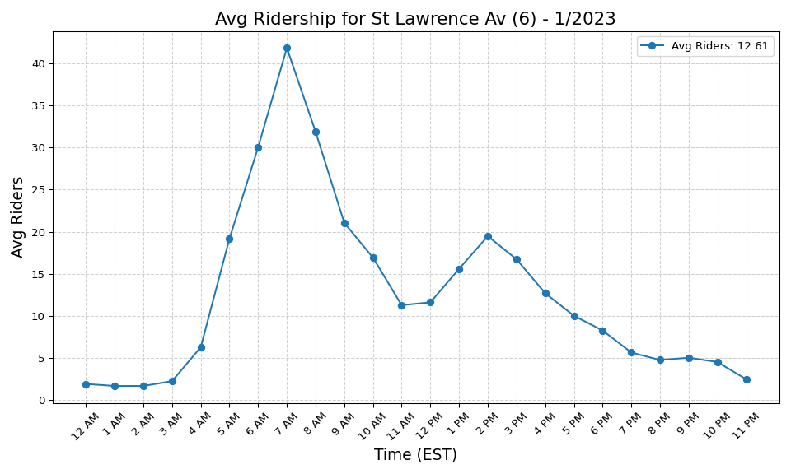
St Lawrence Av (6) - 1/2023

Slide 15
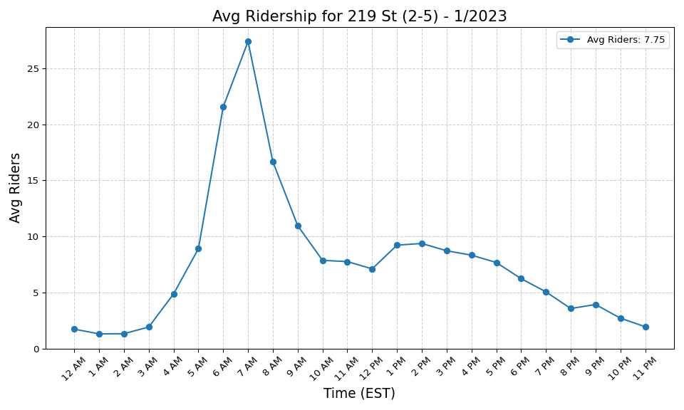
219 St (2-5) - 1/2023

Slide 16
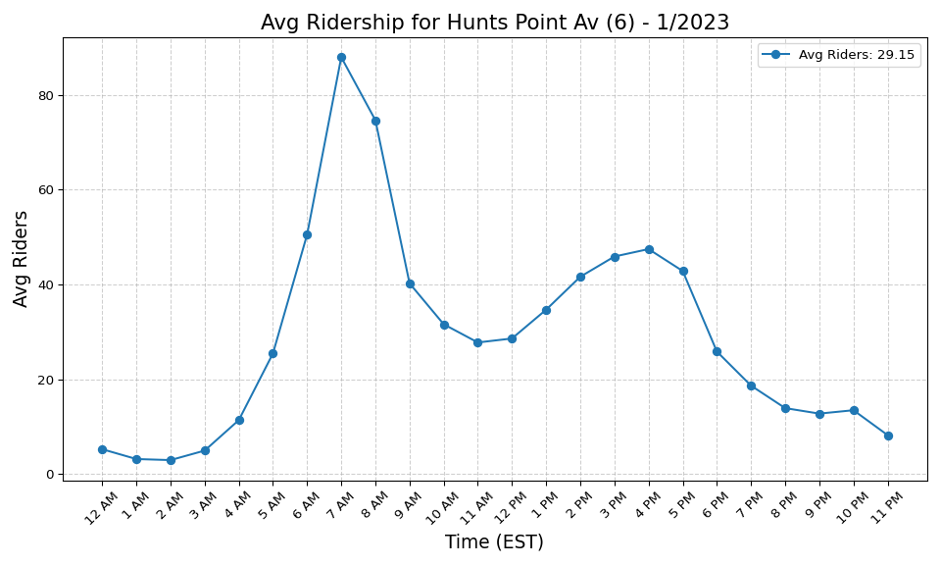
Hunts Point Av (6) - 1/2023

Slide 17
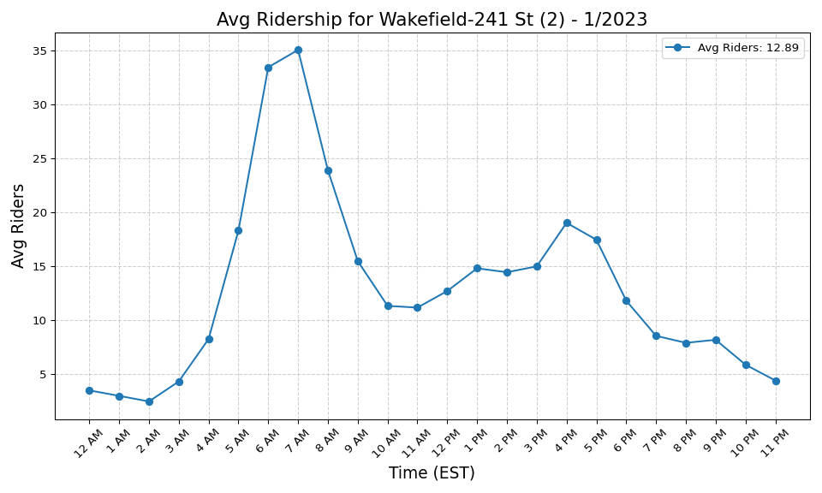
Wakefield-241 St (2) - 1/2023

Slide 18
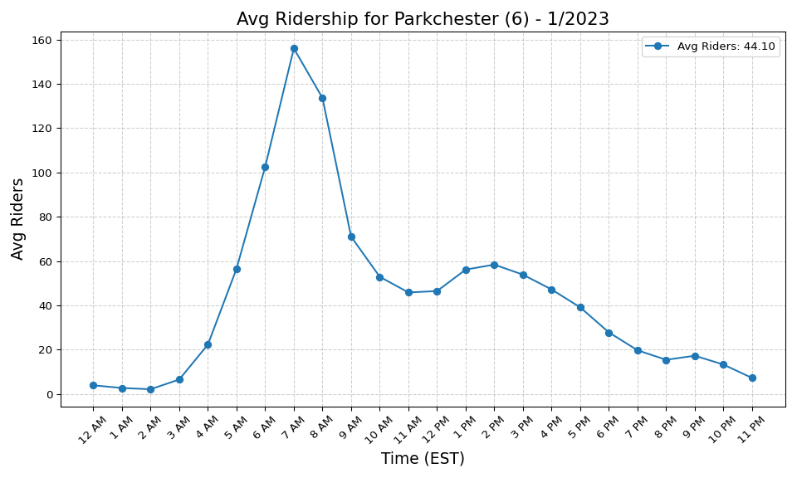
Parkchester (6) - 1/2023

Slide 19
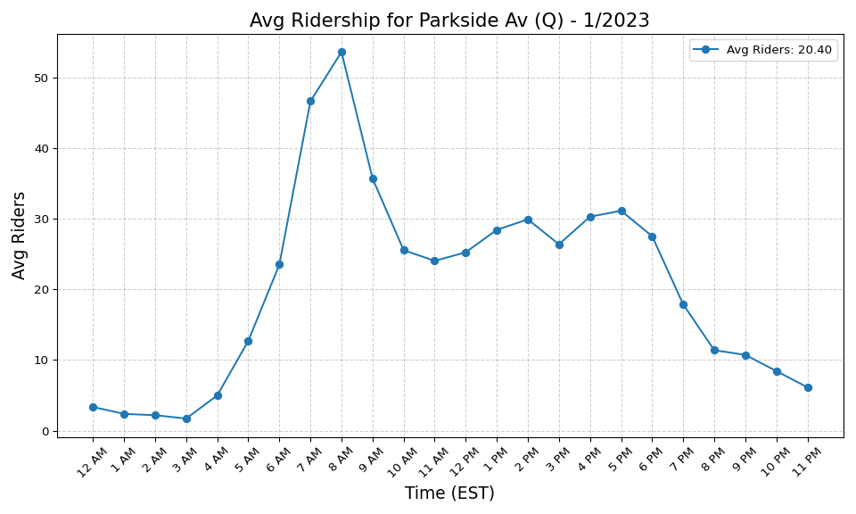
Parkside Av (Q) - 1/2023

Slide 20
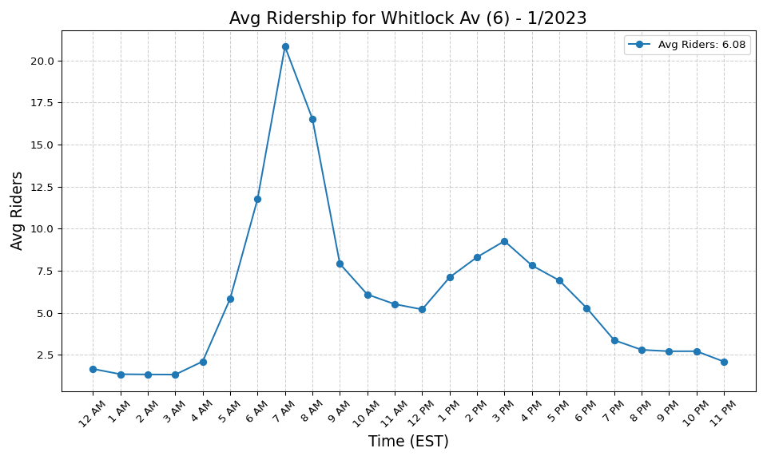
Whitlock Av (6) - 1/2023

Slide 21
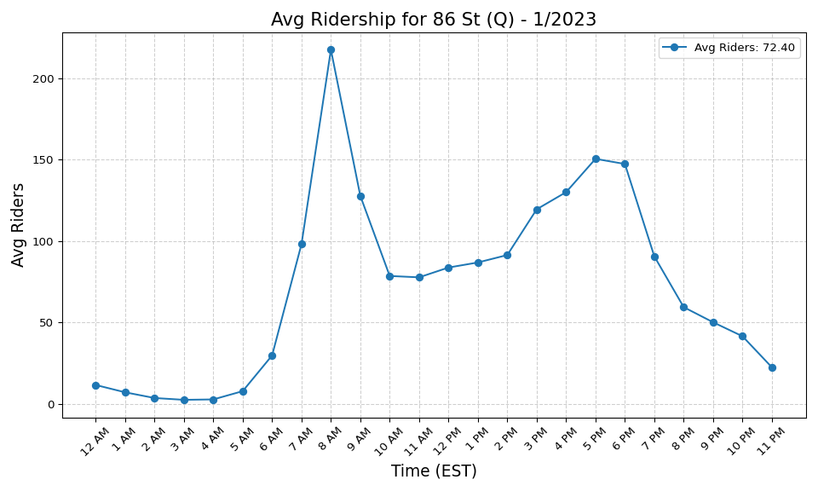
86 St (Q) - 1/2023

Slide 22
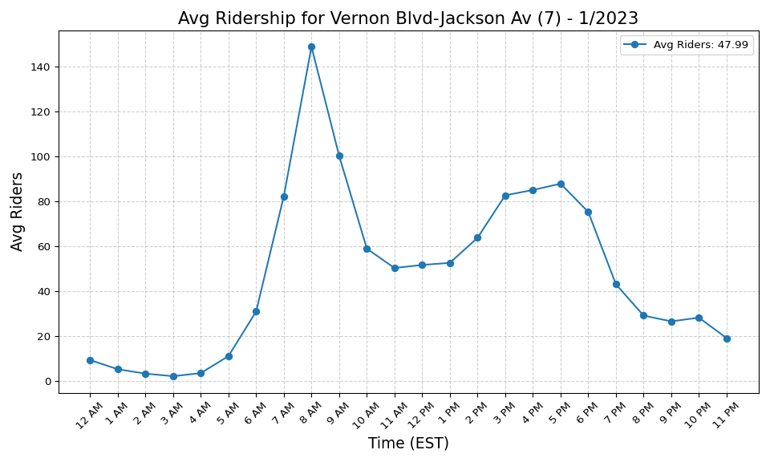
Vernon Blvd-Jackson Av (7) - 1/2023

Slide 23
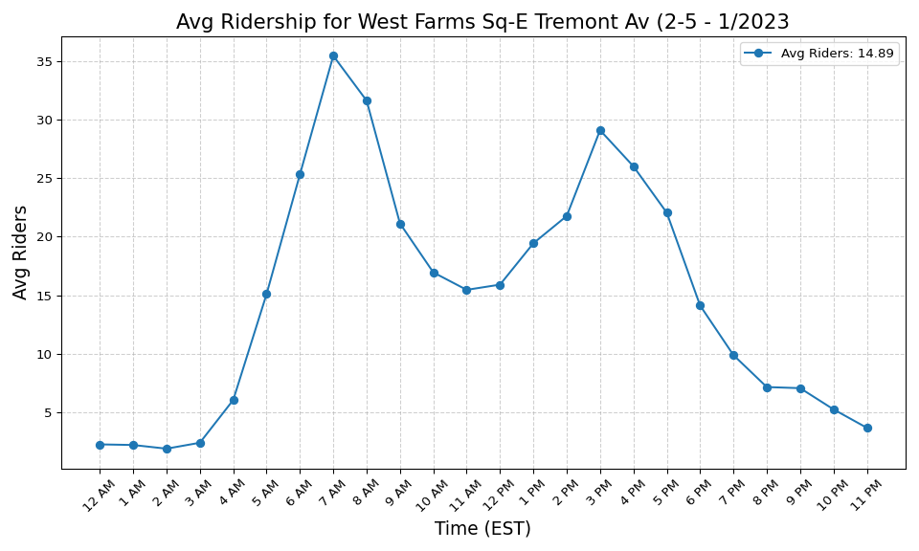
West Farms Sq-E Tremont Av (2-5 - 1/2023

Slide 24
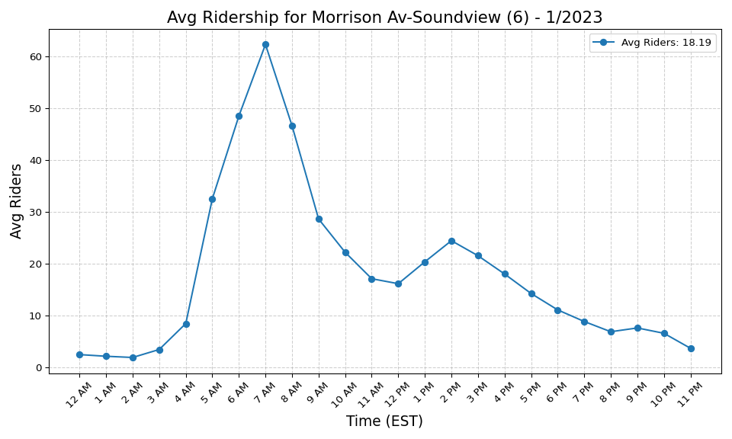
Morrison Av-Soundview (6) - 1/2023

Slide 25
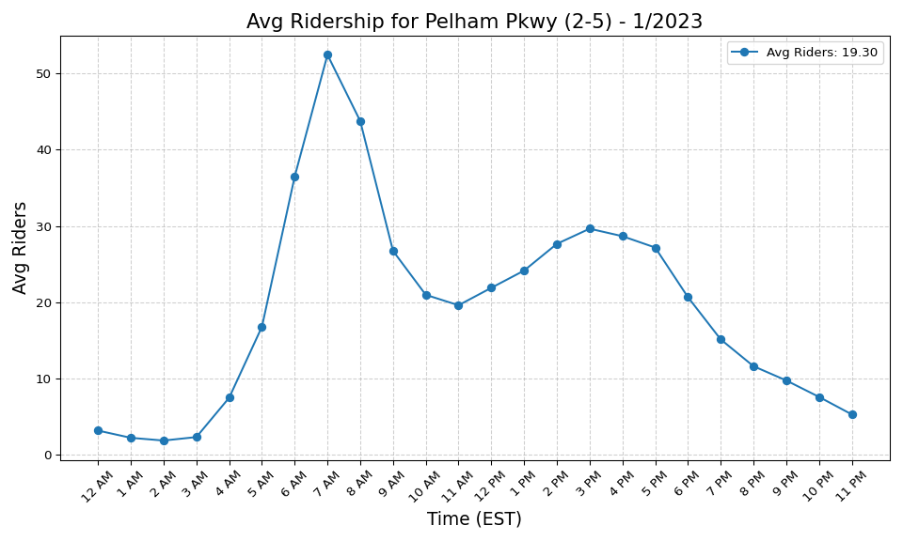
Pelham Pkwy (2-5) - 1/2023

Slide 26

77 St (R) - 1/2023

Slide 27

Burke Av (2-5) - 1/2023

Slide 28
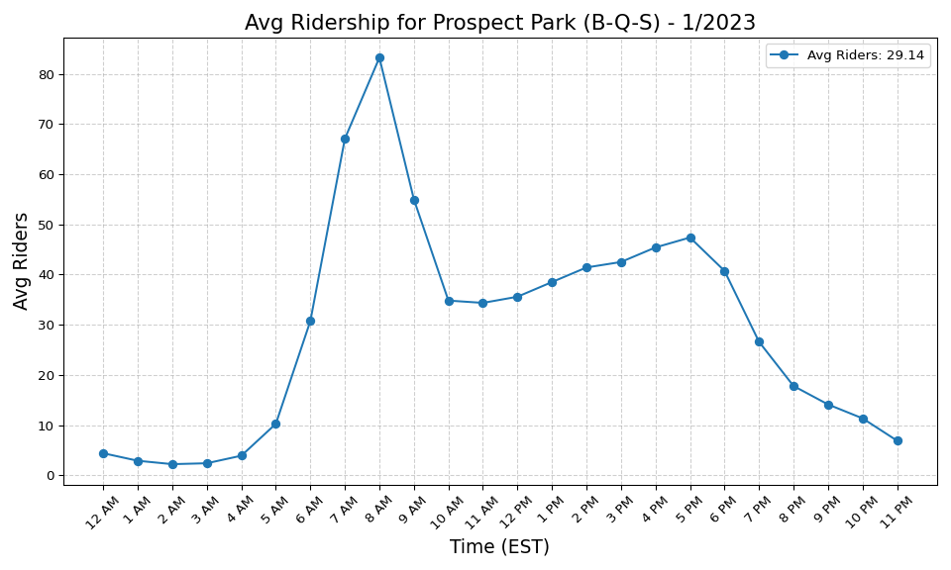
Prospect Park (B-Q-S) - 1/2023

Slide 29
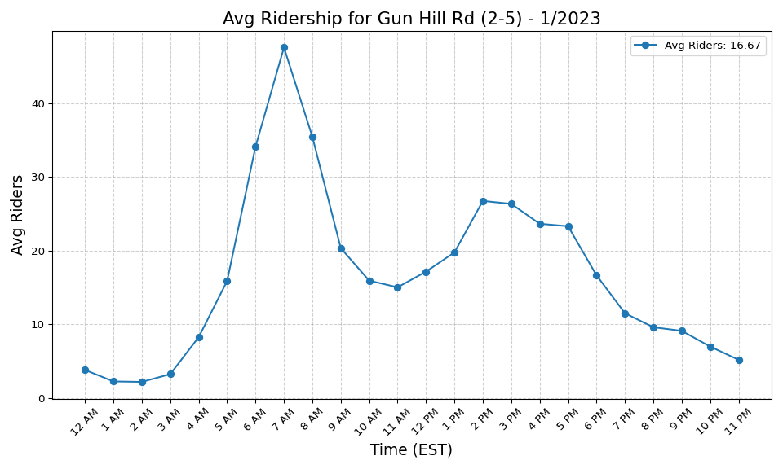
Gun Hill Rd (2-5) - 1/2023

Slide 30
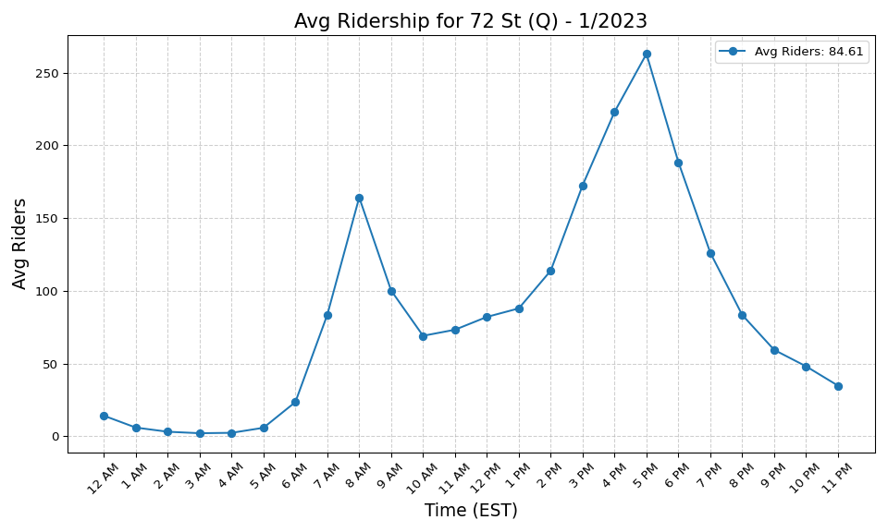
72 St (Q) - 1/2023

Slide 31
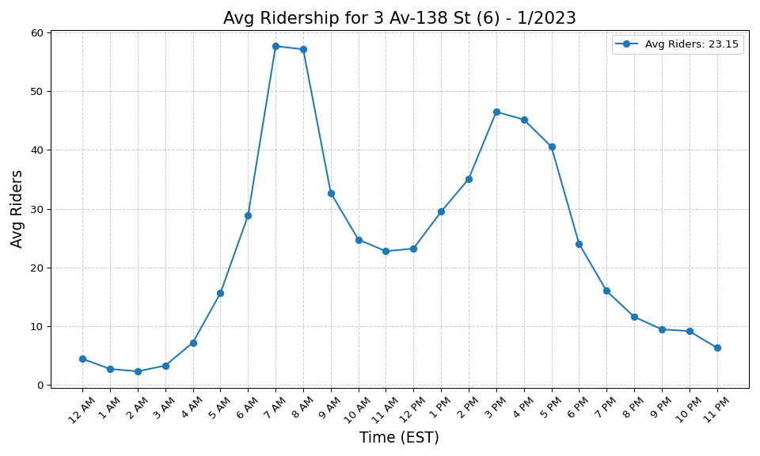
3 Av-138 St (6) - 1/2023

Slide 32
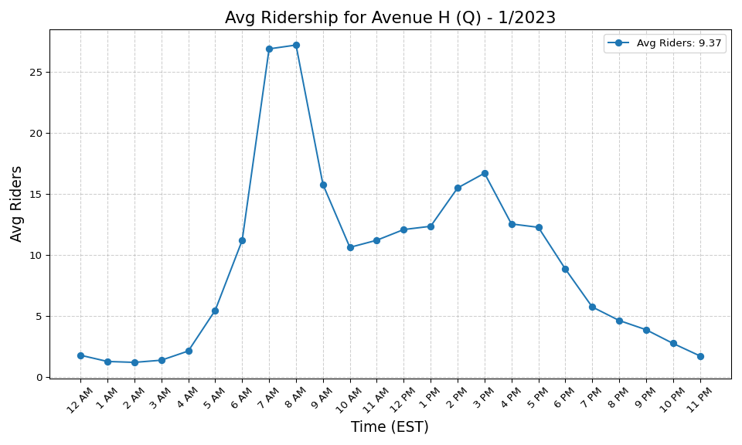
Avenue H (Q) - 1/2023

Slide 33
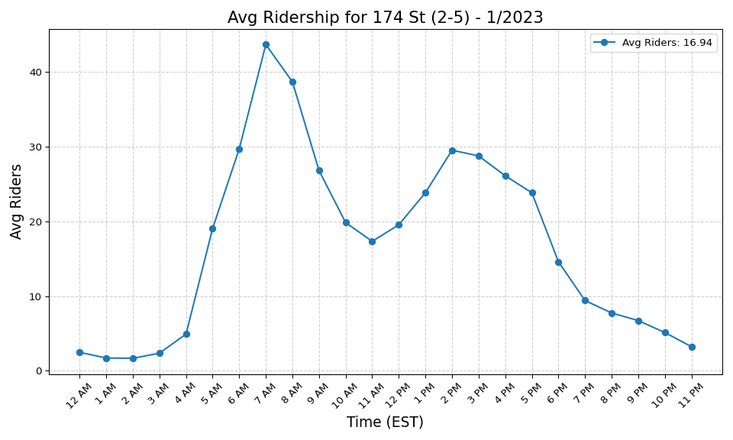
174 St (2-5) - 1/2023

Slide 34
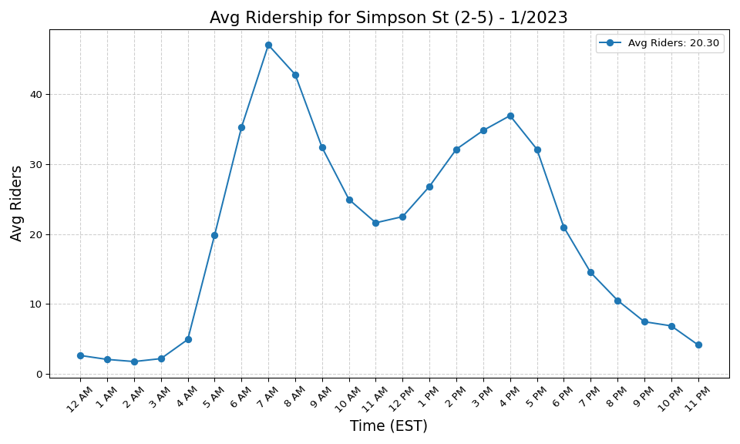
Simpson St (2-5) - 1/2023

Slide 35

233 St (2-5) - 1/2023

Slide 36
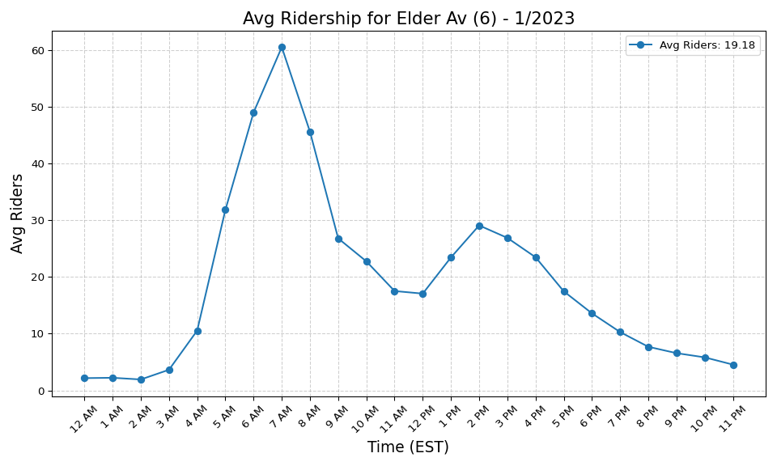
Elder Av (6) - 1/2023

Slide 37
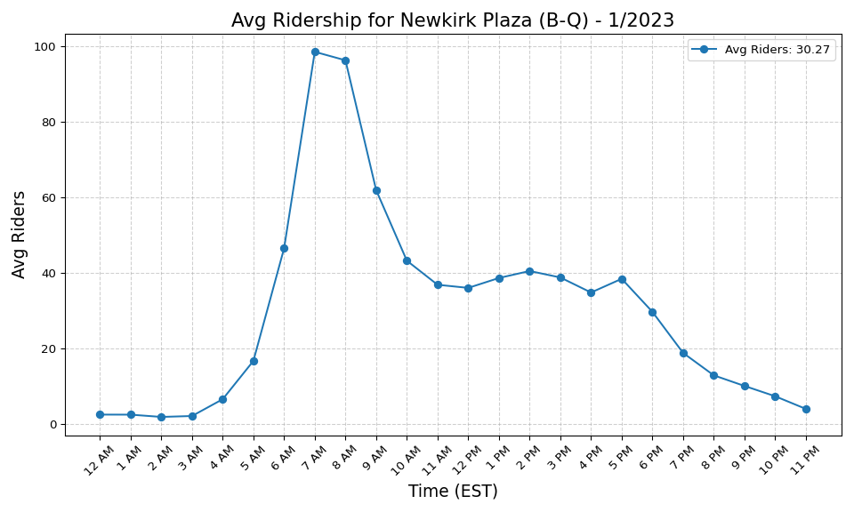
Newkirk Plaza (B-Q) - 1/2023

Slide 38

Castle Hill Av (6) - 1/2023

Slide 39
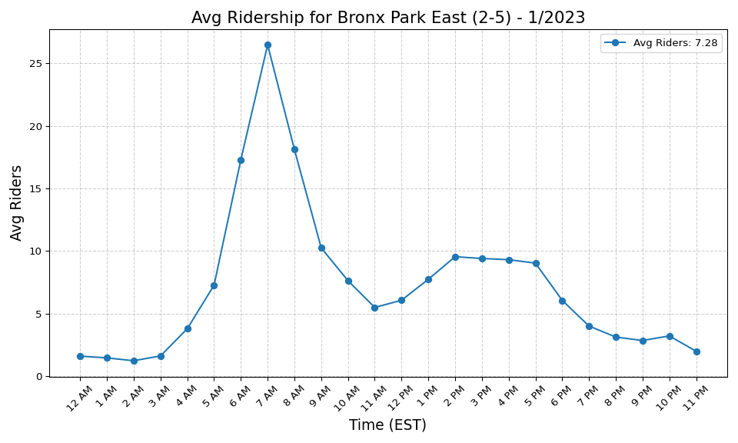
Bronx Park East (2-5) - 1/2023

Slide 40

Zerega Av (6) - 1/2023

Slide 41
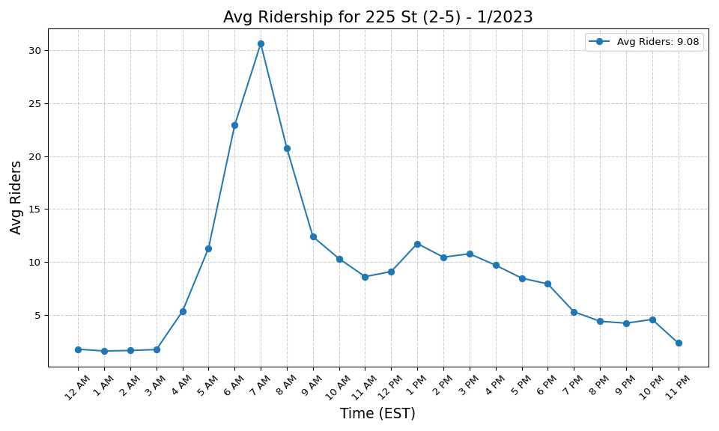
225 St (2-5) - 1/2023

Slide 42
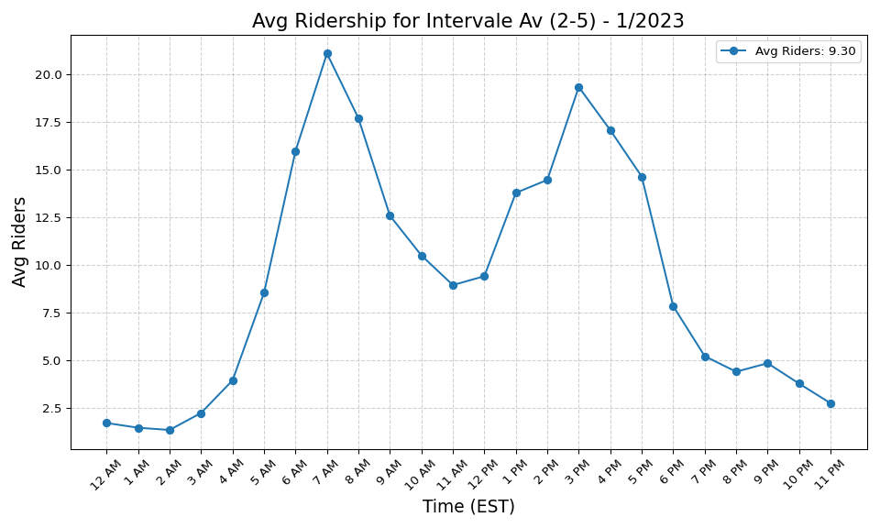
Intervale Av (2-5) - 1/2023

Slide 43
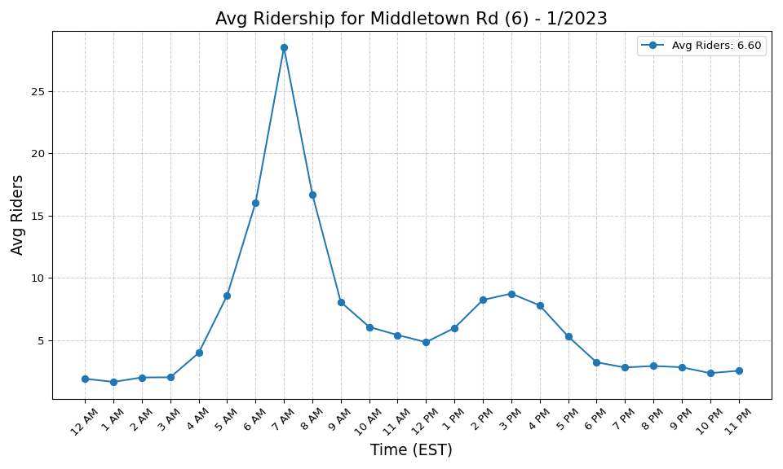
Middletown Rd (6) - 1/2023

Slide 44
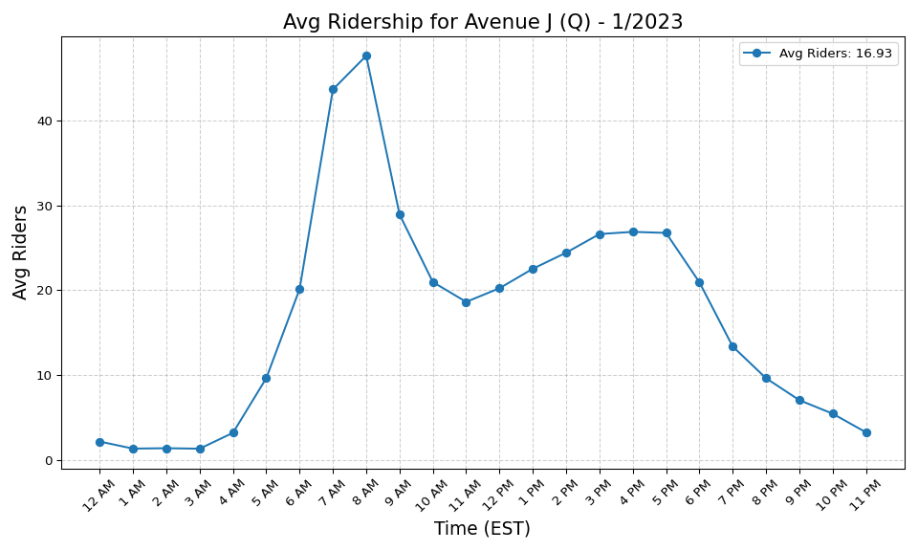
Avenue J (Q) - 1/2023

Slide 45
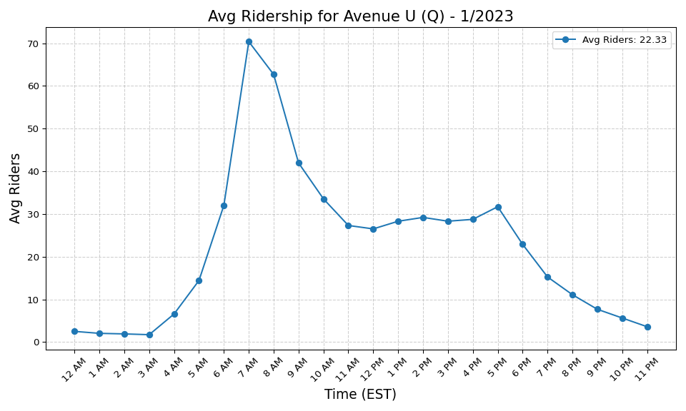
Avenue U (Q) - 1/2023

Slide 46
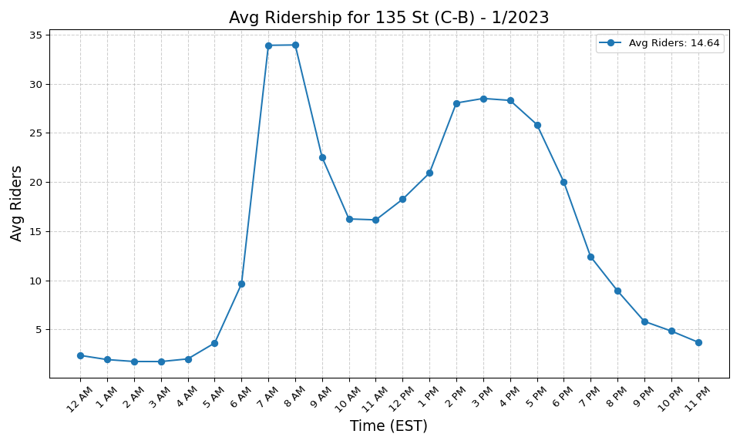
135 St (C-B) - 1/2023

Slide 47
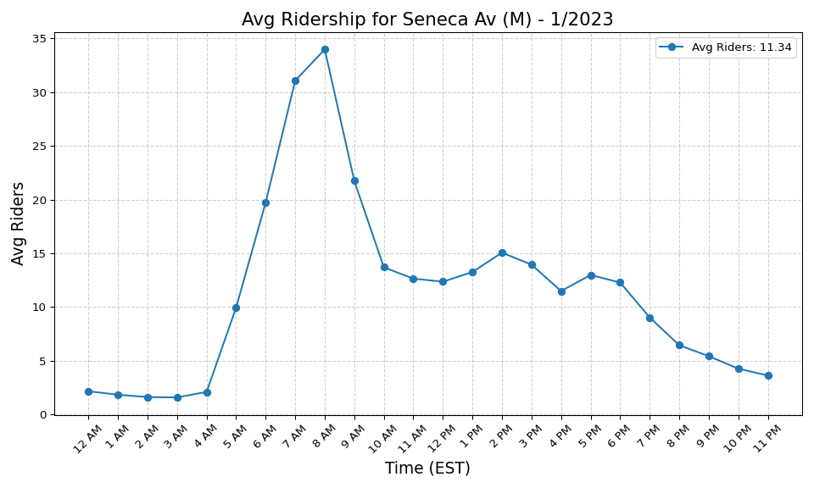
Seneca Av (M) - 1/2023

Slide 48
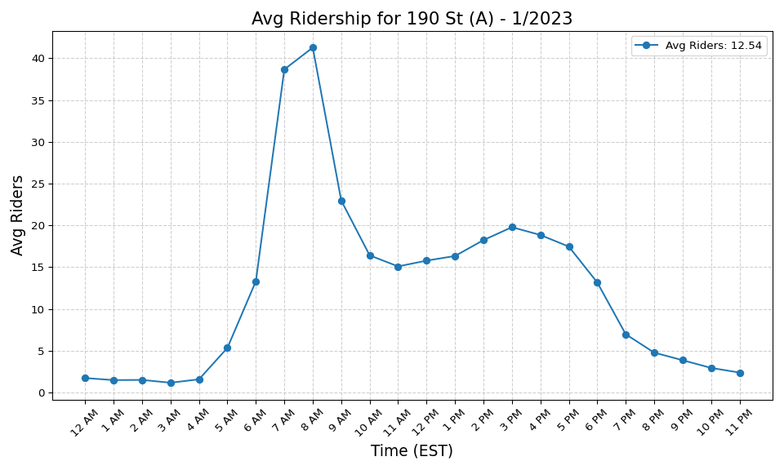
190 St (A) - 1/2023

Slide 49
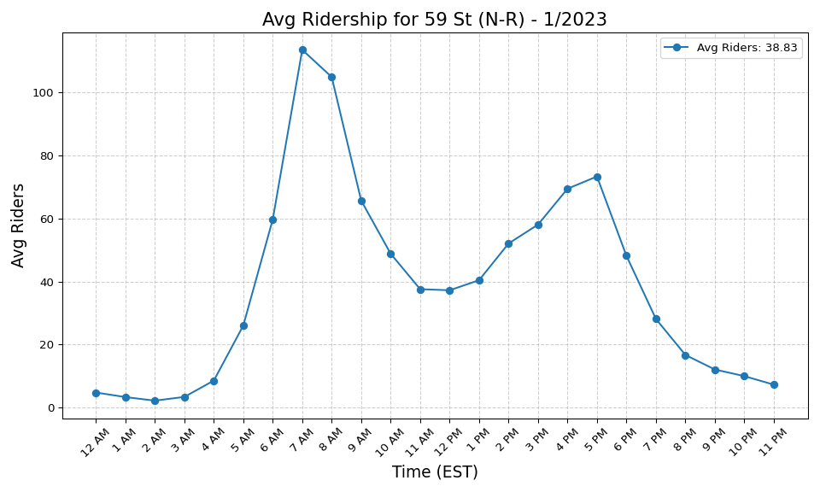
59 St (N-R) - 1/2023

Slide 50
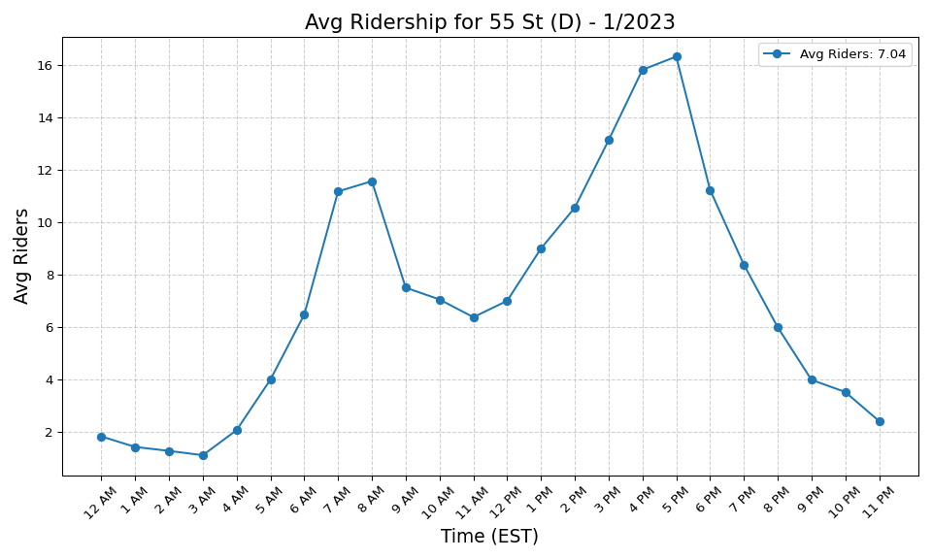
55 St (D) - 1/2023

Slide 51
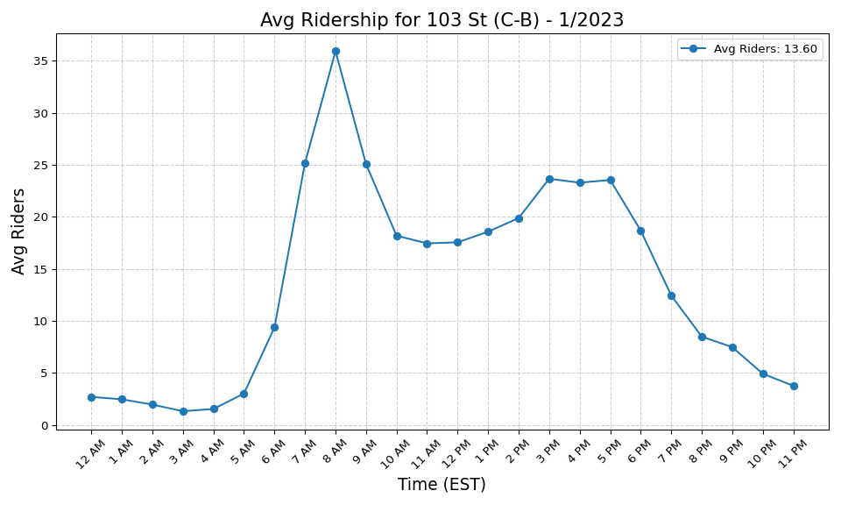
103 St (C-B) - 1/2023

Slide 52
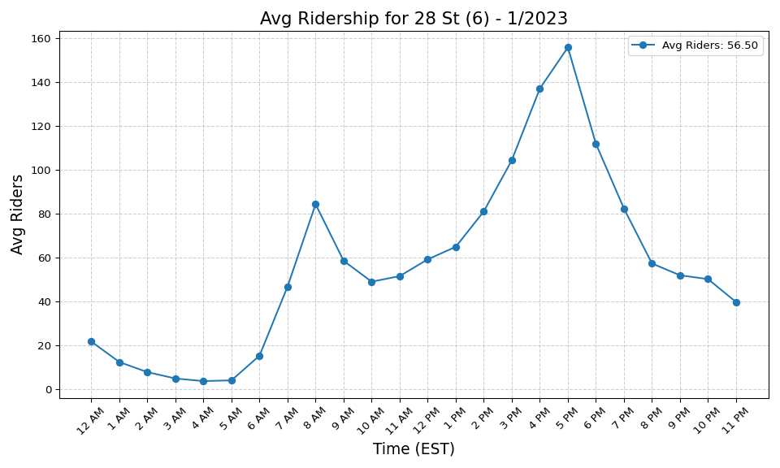
28 St (6) - 1/2023

Slide 53
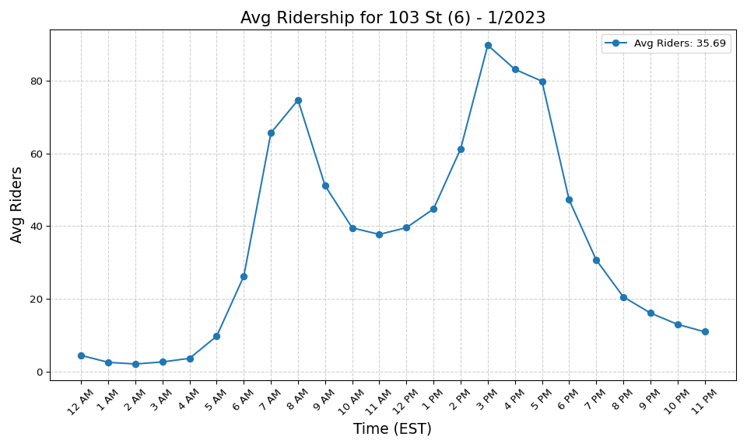
103 St (6) - 1/2023

Slide 54
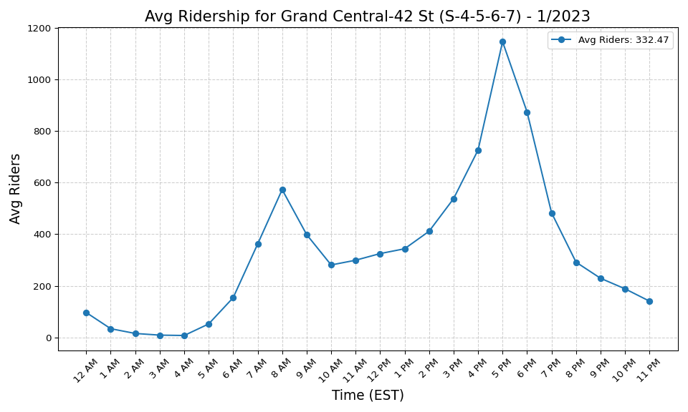
Grand Central-42 St (S-4-5-6-7) - 1/2023

Slide 55
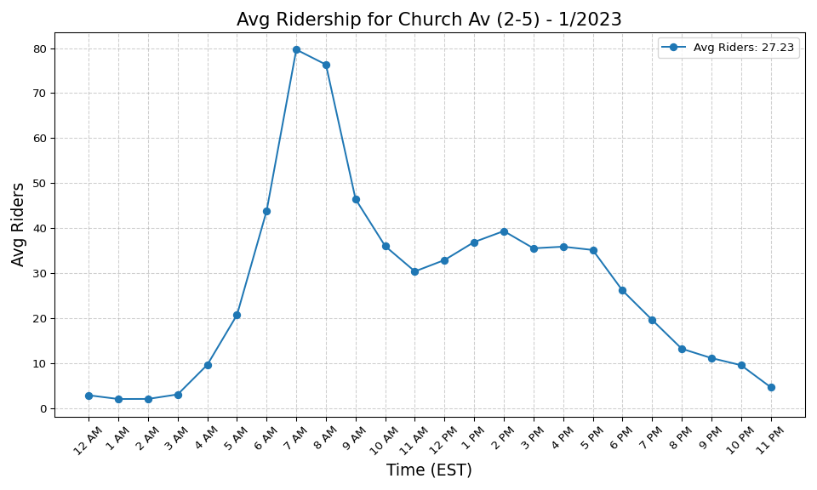
Church Av (2-5) - 1/2023

Slide 56
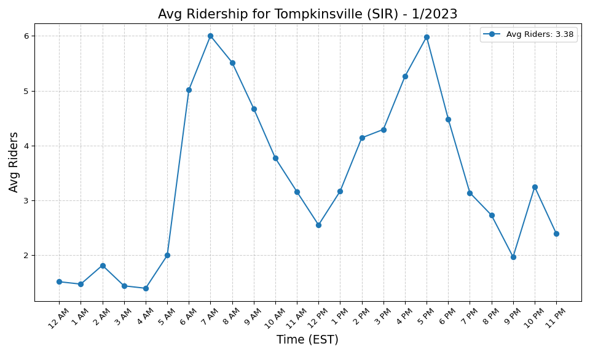
Tompkinsville (SIR) - 1/2023

Slide 57

116 St (C-B) - 1/2023

Slide 58

High St (A-C) - 1/2023

Slide 59

Spring St (6) - 1/2023

Slide 60

Prince St (R-W) - 1/2023

Slide 61

Kings Hwy (B-Q) - 1/2023

Slide 62

Bushwick Av-Aberdeen St (L) - 1/2023

Slide 63

Canal St (A-C-E) - 1/2023

Slide 64

W 4 St-Wash Sq (A-C-E-B-D-F-M) - 1/2023

Slide 65

Fresh Pond Rd (M) - 1/2023

Slide 66

Knickerbocker Av (M) - 1/2023

Slide 67

33 St (6) - 1/2023

Slide 68

Wall St (4-5) - 1/2023

Slide 69

8 St-NYU (R-W) - 1/2023

Slide 70

Jefferson St (L) - 1/2023

Slide 71

23 St (R-W) - 1/2023

Slide 72

175 St (A) - 1/2023

Slide 73

Ralph Av (C) - 1/2023

Slide 74

Times Sq-42 St (N-Q-R-W-S-1-2-3 - 1/2023

Slide 75

President St-Medgar Evers Colle - 1/2023

Slide 76

New Utrecht Av (N)-62 St (D) - 1/2023

Slide 77

Winthrop St (2-5) - 1/2023

Slide 78

Sheepshead Bay (B-Q) - 1/2023

Slide 79

Ocean Pkwy (Q) - 1/2023

Slide 80

Forest Av (M) - 1/2023

Slide 81

59 St-Columbus Circle (A-B-C-D- - 1/2023

Slide 82

Junius St (3) - 1/2023

Slide 83

Lafayette Av (C) - 1/2023

Slide 84

81 St-Museum of Natural History - 1/2023

Slide 85

Flatbush Av-Brooklyn College (2 - 1/2023

Slide 86

Lexington Av (N-R-W)-59 St (4-5 - 1/2023

Slide 87

163 St-Amsterdam Av (C) - 1/2023

Slide 88

Central Av (M) - 1/2023

Slide 89

155 St (C) - 1/2023

Slide 90

Broadway-Lafayette St (B-D-F-M) - 1/2023

Slide 91

Atlantic Av (L) - 1/2023

Slide 92

Court St (R)-Borough Hall (2-3- - 1/2023

Slide 93

23 St (C-E) - 1/2023

Slide 94

Brighton Beach (B-Q) - 1/2023

Slide 95

Spring St (C-E) - 1/2023

Slide 96

23 St (6) - 1/2023

Slide 97

77 St (6) - 1/2023

Slide 98

Lexington Av-53 St (E-M)-51 St - 1/2023

Slide 99

Newkirk Av-Little Haiti (2-5) - 1/2023

Slide 100

72 St (C-B) - 1/2023

Slide 101

Pelham Bay Park (6) - 1/2023

Slide 102

96 St (6) - 1/2023

Slide 103

34 St-Penn Station (A-C-E) - 1/2023

Slide 104

110 St (6) - 1/2023

Slide 105

Hewes St (M-J) - 1/2023

Slide 106

Utica Av (A-C) - 1/2023

Slide 107

Van Siclen Av (3) - 1/2023

Slide 108

49 St (N-R-W) - 1/2023

Slide 109

50 St (D) - 1/2023

Slide 110

New Lots Av (L) - 1/2023

Slide 111

Wilson Av (L) - 1/2023

Slide 112

145 St (A-C-B-D) - 1/2023

Slide 113

Bryant Pk (B-D-F-M)-5 Av (7) - 1/2023

Slide 114

Cathedral Pkwy (110 St) (C-B) - 1/2023

Slide 115

Hoyt-Schermerhorn Sts (A-C-G) - 1/2023

Slide 116

Grand St (L) - 1/2023

Slide 117

1 Av (L) - 1/2023

Slide 118

St George (SIR) - 1/2023

Slide 119

68 St-Hunter College (6) - 1/2023

Slide 120

86 St (4-5-6) - 1/2023

Slide 121

Broad St (J-Z) - 1/2023

Slide 122

28 St (R-W) - 1/2023

Slide 123

Clinton-Washington Avs (C) - 1/2023

Slide 124

3 Av (L) - 1/2023

Slide 125

Park Pl (S) - 1/2023

Slide 126

Avenue M (Q) - 1/2023

Slide 127

Bay Ridge Av (R) - 1/2023

Slide 128

DeKalb Av (L) - 1/2023

Slide 129

Marcy Av (M-J-Z) - 1/2023

Slide 130

36 Av (N-W) - 1/2023

Slide 131

181 St (A) - 1/2023

Slide 132

Graham Av (L) - 1/2023

Slide 133

Dyckman St (A) - 1/2023

Slide 134

Neck Rd (Q) - 1/2023

Slide 135

Halsey St (L) - 1/2023

Slide 136

New Lots Av (3) - 1/2023

Slide 137

125 St (A-C-B-D) - 1/2023

Slide 138

Morgan Av (L) - 1/2023

Slide 139

Kingston-Throop Avs (C) - 1/2023

Slide 140

50 St (C-E) - 1/2023

Slide 141

74-Broadway (7)-Jackson Hts-Roo - 1/2023

Slide 142

Montrose Av (L) - 1/2023

Slide 143

96 St (C-B) - 1/2023

Slide 144

Sutter Av (L) - 1/2023

Slide 145

Astor Pl (6) - 1/2023

Slide 146

Bowery (J-Z) - 1/2023

Slide 147

Rockaway Av (C) - 1/2023

Slide 148

Bedford Av (L) - 1/2023

Slide 149

Livonia Av (L) - 1/2023

Slide 150

Pennsylvania Av (3) - 1/2023

Slide 151

Sterling St (2-5) - 1/2023

Slide 152

Middle Village-Metropolitan Av - 1/2023

Slide 153

86 St (C-B) - 1/2023

Slide 154

Astoria-Ditmars Blvd (N-W) - 1/2023

Slide 155

14 St (A-C-E)-8 Av (L) - 1/2023

Slide 156

Atlantic Av-Barclays Ctr (B-D-N - 1/2023

Slide 157

Broadway (N-W) - 1/2023

Slide 158

Inwood-207 St (A) - 1/2023

Slide 159

East 105 St (L) - 1/2023

Slide 160

Nostrand Av (A-C) - 1/2023

Slide 161

Rockaway Av (3) - 1/2023

Slide 162

Beverly Rd (2-5) - 1/2023

Slide 163

Bowling Green (4-5) - 1/2023

Slide 164

Canarsie-Rockaway Pkwy (L) - 1/2023

Slide 165

7 Av (B-Q) - 1/2023

Slide 166

36 St (M-R) - 1/2023

Slide 167

21 St (G) - 1/2023

Slide 168

69 St (7) - 1/2023

Slide 169

Avenue X (F) - 1/2023

Slide 170

Wall St (2-3) - 1/2023

Slide 171

57 St (F) - 1/2023

Slide 172

Briarwood (E-F) - 1/2023

Slide 173

Nassau Av (G) - 1/2023

Slide 174

18 Av (F) - 1/2023

Slide 175

67 Av (M-R) - 1/2023

Slide 176

169 St (F) - 1/2023

Slide 177

Beach 36 St (A) - 1/2023

Slide 178

88 St (A) - 1/2023

Slide 179

174-175 Sts (B-D) - 1/2023

Slide 180

Avenue P (F) - 1/2023

Slide 181

23 St (F-M) - 1/2023

Slide 182

65 St (M-R) - 1/2023

Slide 183

104 St (A) - 1/2023

Slide 184

Ditmas Av (F) - 1/2023

Slide 185

52 St (7) - 1/2023

Slide 186

Beach 25 St (A) - 1/2023

Slide 187

Hoyt St (2-3) - 1/2023

Slide 188

80 St (A) - 1/2023

Slide 189

Tremont Av (B-D) - 1/2023

Slide 190

46 St (M-R) - 1/2023

Slide 191

DeKalb Av (B-Q-R) - 1/2023

Slide 192

Aqueduct Racetrack (A) - 1/2023

Slide 193

111 St (7) - 1/2023

Slide 194

Shepherd Av (C) - 1/2023

Slide 195

Queens Plaza (E-M-R) - 1/2023

Slide 196

Rector St (1) - 1/2023

Slide 197

Broadway (G) - 1/2023

Slide 198

Euclid Av (A-C) - 1/2023

Slide 199

Queensboro Plaza (7-N-W) - 1/2023

Slide 200

Steinway St (M-R) - 1/2023

Slide 201

Northern Blvd (M-R) - 1/2023

Slide 202

Rector St (R-W) - 1/2023

Slide 203

2 Av (F) - 1/2023

Slide 204

167 St (B-D) - 1/2023

Slide 205

Fulton St (G) - 1/2023

Slide 206

63 Dr-Rego Park (M-R) - 1/2023

Slide 207

61 St-Woodside (7) - 1/2023

Slide 208

Carroll St (F-G) - 1/2023

Slide 209

Beach 98 St (A-S) - 1/2023

Slide 210

Parsons Blvd (F) - 1/2023

Slide 211

15 St-Prospect Park (F-G) - 1/2023

Slide 212

170 St (B-D) - 1/2023

Slide 213

Grant Av (A) - 1/2023

Slide 214

City Hall (R-W) - 1/2023

Slide 215

7 Av (E-B-D) - 1/2023

Slide 216

Van Cortlandt Park-242 St (1) - 1/2023

Slide 217

Junction Blvd (7) - 1/2023

Slide 218

Astoria Blvd (N-W) - 1/2023

Slide 219

Neptune Av (F) - 1/2023

Slide 220

21 St-Queensbridge (F) - 1/2023

Slide 221

Jamaica-179 St (F) - 1/2023

Slide 222

Norwood-205 St (D) - 1/2023

Slide 223

Rockaway Blvd (A) - 1/2023

Slide 224

Chambers St (1-2-3) - 1/2023

Slide 225

Classon Av (G) - 1/2023

Slide 226

Howard Beach-JFK Airport (A) - 1/2023

Slide 227

103 St-Corona Plaza (7) - 1/2023

Slide 228

Woodhaven Blvd (M-R) - 1/2023

Slide 229

90 St-Elmhurst Av (7) - 1/2023

Slide 230

Flushing Av (G) - 1/2023

Slide 231

Elmhurst Av (M-R) - 1/2023

Slide 232

Kingsbridge Rd (B-D) - 1/2023

Slide 233

Jamaica-Van Wyck (E) - 1/2023

Slide 234

York St (F) - 1/2023

Slide 235

Greenpoint Av (G) - 1/2023

Slide 236

Bedford Park Blvd (B-D) - 1/2023

Slide 237

111 St (A) - 1/2023

Slide 238

Fort Hamilton Pkwy (F-G) - 1/2023

Slide 239

Cortelyou Rd (Q) - 1/2023

Slide 240

Kew Gardens-Union Tpke (E-F) - 1/2023

Slide 241

5 Av-53 St (E-M) - 1/2023

Slide 242

47-50 Sts-Rockefeller Ctr (B-D- - 1/2023

Slide 243

Lexington Av-63 St (F-Q) - 1/2023

Slide 244

Van Siclen Av (C) - 1/2023

Slide 245

WTC Cortlandt (1) - 1/2023

Slide 246

Nevins St (2-3-4-5) - 1/2023

Slide 247

Smith-9 Sts (F-G) - 1/2023

Slide 248

Bedford-Nostrand Avs (G) - 1/2023

Slide 249

40 St-Lowery St (7) - 1/2023

Slide 250

Avenue I (F) - 1/2023

Slide 251

45 St (R) - 1/2023

Slide 252

Jamaica Center-Parsons-Archer ( - 1/2023

Slide 253

Far Rockaway-Mott Av (A) - 1/2023

Slide 254

155 St (B-D) - 1/2023

Slide 255

Grand St (B-D) - 1/2023

Slide 256

7 Av (F-G) - 1/2023

Slide 257

Clark St (2-3) - 1/2023

Slide 258

Liberty Av (C) - 1/2023

Slide 259

46 St-Bliss St (7) - 1/2023

Slide 260

Kings Hwy (F) - 1/2023

Slide 261

Fordham Rd (B-D) - 1/2023

Slide 262

Roosevelt Island (F) - 1/2023

Slide 263

Aqueduct-N Conduit Av (A) - 1/2023

Slide 264

Bergen St (F-G) - 1/2023

Slide 265

Sutphin Blvd (F) - 1/2023

Slide 266

Union St (R) - 1/2023

Slide 267

Grand Av-Newtown (M-R) - 1/2023

Slide 268

Beach 67 St (A) - 1/2023

Slide 269

33 St-Rawson St (7) - 1/2023

Slide 270

182-183 Sts (B-D) - 1/2023

Slide 271

Ozone Park-Lefferts Blvd (A) - 1/2023

Slide 272

Avenue U (F) - 1/2023

Slide 273

Sutphin Blvd-Archer Av-JFK Airp - 1/2023

Slide 274

East Broadway (F) - 1/2023

Slide 275

Forest Hills-71 Av (E-F-M-R) - 1/2023

Slide 276

Beach 44 St (A) - 1/2023

Slide 277

Myrtle-Willoughby Avs (G) - 1/2023

Slide 278

Avenue N (F) - 1/2023

Slide 279

82 St-Jackson Hts (7) - 1/2023

Slide 280

Bay Pkwy (F) - 1/2023

Slide 281

Church Av (F-G) - 1/2023

Slide 282

75 Av (E-F) - 1/2023

Slide 283

Beach 105 St (A-S) - 1/2023

Slide 284

Beach 90 St (A-S) - 1/2023

Slide 285

Beach 60 St (A) - 1/2023

Slide 286

Clinton-Washington Avs (G) - 1/2023

Slide 287

Beverley Rd (Q) - 1/2023

Slide 288

Broad Channel (A-S) - 1/2023

Slide 289

Hunters Point Av (7) - 1/2023

Slide 290

Rockaway Park-Beach 116 St (A-S - 1/2023

Slide 291

238 St (1) - 1/2023

Slide 292

Franklin St (1) - 1/2023

Slide 293

Mets-Willets Point (7) - 1/2023

Slide 294

176 St (4) - 1/2023

Slide 295

170 St (4) - 1/2023

Slide 296

50 St (1) - 1/2023

Slide 297

25 Av (D) - 1/2023

Slide 298

Mosholu Pkwy (4) - 1/2023

Slide 299

36 St (D-N-R) - 1/2023

Slide 300

104 St (J-Z) - 1/2023

Slide 301

Mt Eden Av (4) - 1/2023

Slide 302

116 St (2-3) - 1/2023

Slide 303

125 St (2-3) - 1/2023

Slide 304

79 St (D) - 1/2023

Slide 305

231 St (1) - 1/2023

Slide 306

Canal St (1) - 1/2023

Slide 307

86 St (N) - 1/2023

Slide 308

18 St (1) - 1/2023

Slide 309

86 St (R) - 1/2023

Slide 310

Morris Park (5) - 1/2023

Slide 311

30 Av (N-W) - 1/2023

Slide 312

167 St (4) - 1/2023

Slide 313

Bay Pkwy (N) - 1/2023

Slide 314

Bay 50 St (D) - 1/2023

Slide 315

20 Av (N) - 1/2023

Slide 316

191 St (1) - 1/2023

Slide 317

86 St (1) - 1/2023

Slide 318

157 St (1) - 1/2023

Slide 319

135 St (2-3) - 1/2023

Slide 320

8 Av (N) - 1/2023

Slide 321

23 St (1) - 1/2023

Slide 322

111 St (J) - 1/2023

Slide 323

20 Av (D) - 1/2023

Slide 324

121 St (J-Z) - 1/2023

Slide 325

Van Siclen Av (J-Z) - 1/2023

Slide 326

39 Av-Dutch Kills (N-W) - 1/2023

Slide 327

Eastern Pkwy-Brooklyn Museum (2 - 1/2023

Slide 328

57 St-7 Av (N-Q-R-W) - 1/2023

Slide 329

Flushing-Main St (7) - 1/2023

Slide 330

145 St (3) - 1/2023

Slide 331

Kingston Av (3) - 1/2023

Slide 332

Bergen St (2-3) - 1/2023

Slide 333

Fordham Rd (4) - 1/2023

Slide 334

Harlem-148 St (3) - 1/2023

Slide 335

Jackson Av (2-5) - 1/2023

Slide 336

34 St-Penn Station (1-2-3) - 1/2023

Slide 337

215 St (1) - 1/2023

Slide 338

28 St (1) - 1/2023

Slide 339

Avenue U (N) - 1/2023

Slide 340

Kosciuszko St (J) - 1/2023

Slide 341

Woodlawn (4) - 1/2023

Slide 342

Woodhaven Blvd (J-Z) - 1/2023

Slide 343

Gun Hill Rd (5) - 1/2023

Slide 344

Prospect Av (R) - 1/2023

Slide 345

161 St-Yankee Stadium (B-D-4) - 1/2023

Slide 346

Norwood Av (J-Z) - 1/2023

Slide 347

181 St (1) - 1/2023

Slide 348

Sutter Av-Rutland Rd (3) - 1/2023

Slide 349

W 8 St-NY Aquarium (F-Q) - 1/2023

Slide 350

Crown Hts-Utica Av (3-4) - 1/2023

Slide 351

14 St-Union Sq (L-N-Q-R-W-4-5-6 - 1/2023

Slide 352

Marble Hill-225 St (1) - 1/2023

Slide 353

Church Av (B-Q) - 1/2023

Slide 354

Gates Av (J-Z) - 1/2023

Slide 355

125 St (1) - 1/2023

Slide 356

14 St (F-M-1-2-3)-6 Av (L) - 1/2023

Slide 357

85 St-Forest Pkwy (J) - 1/2023

Slide 358

75 St-Elderts Ln (J-Z) - 1/2023

Slide 359

4 Av (F-G)-9 St (R) - 1/2023

Slide 360

183 St (4) - 1/2023

Slide 361

25 St (R) - 1/2023

Slide 362

Prospect Av (2-5) - 1/2023

Slide 363

3 Av-149 St (2-5) - 1/2023

Slide 364

Saratoga Av (3) - 1/2023

Slide 365

18 Av (N) - 1/2023

Slide 366

Bay Pkwy (D) - 1/2023

Slide 367

137 St-City College (1) - 1/2023

Slide 368

Myrtle Av (M-J-Z) - 1/2023

Slide 369

116 St-Columbia University (1) - 1/2023

Slide 370

Nostrand Av (3) - 1/2023

Slide 371

Lorimer St (M-J) - 1/2023

Slide 372

Baychester Av (5) - 1/2023

Slide 373

Dyckman St (1) - 1/2023

Slide 374

Pelham Pkwy (5) - 1/2023

Slide 375

5 Av-59 St (N-R-W) - 1/2023

Slide 376

Coney Island-Stillwell Av (D-F- - 1/2023

Slide 377

Kingsbridge Rd (4) - 1/2023

Slide 378

9 Av (D) - 1/2023

Slide 379

Cypress Hills (J) - 1/2023

Slide 380

Christopher St-Sheridan Sq (1) - 1/2023

Slide 381

66 St-Lincoln Center (1) - 1/2023

Slide 382

Bedford Park Blvd-Lehman Colleg - 1/2023

Slide 383

Cathedral Pkwy (110 St) (1) - 1/2023

Slide 384

Fort Hamilton Pkwy (N) - 1/2023

Slide 385

Alabama Av (J) - 1/2023

Slide 386

138 St-Grand Concourse (4-5) - 1/2023

Slide 387

Grand Army Plaza (2-3) - 1/2023

Slide 388

72 St (1-2-3) - 1/2023

Slide 389

149 St-Grand Concourse (2-4-5) - 1/2023

Slide 390

116 St (6) - 1/2023

Slide 391

Cleveland St (J) - 1/2023

Slide 392

Fort Hamilton Pkwy (D) - 1/2023

Slide 393

Eastchester-Dyre Av (5) - 1/2023

Slide 394

Flushing Av (M-J) - 1/2023

Slide 395

168 St (A-C-1) - 1/2023

Slide 396

103 St (1) - 1/2023

Slide 397

Halsey St (J) - 1/2023

Slide 398

Houston St (1) - 1/2023

Slide 399

207 St (1) - 1/2023

Slide 400

96 St (1-2-3) - 1/2023

Slide 401

34 St-Herald Sq (B-D-F-M-N-Q-R- - 1/2023

Slide 402

Bay Ridge-95 St (R) - 1/2023

Slide 403

Kings Hwy (N) - 1/2023

Slide 404

18 Av (D) - 1/2023

Slide 405

125 St (4-5-6) - 1/2023

Slide 406

53 St (R) - 1/2023

Slide 407

79 St (1) - 1/2023

Slide 408

Court Sq (E-G-M-7) - 1/2023

Slide 409

Chauncey St (J-Z) - 1/2023

Slide 410

Central Park North (110 St) (2- - 1/2023

Slide 411

Burnside Av (4) - 1/2023

Slide 412

145 St (1) - 1/2023

Slide 413

Crescent St (J-Z) - 1/2023

Slide 414

South Ferry (1)-Whitehall St (R - 1/2023

Slide 415

Canal St (J-N-Q-R-W-Z-6) - 1/2023

Slide 416

Chambers St (A-C)-WTC (E)-Park - 1/2023

Slide 417

Franklin Av (C-S) - 1/2023

Slide 418

Fulton St (A-C-J-Z-2-3-4-5) - 1/2023

Slide 419

Delancey St (F)-Essex St (J-M-Z - 1/2023

Slide 420

RI Tramway (Manhattan) - 1/2023

Slide 421

71 St (D) - 1/2023

Slide 422

Myrtle-Wyckoff Avs (L-M) - 1/2023

Slide 423

Lorimer St (L)-Metropolitan Av - 1/2023

Slide 424

Broadway Junction (A-C-J-L-Z) - 1/2023

Slide 425

RI Tramway (Roosevelt) - 1/2023

Slide 426

Franklin Av (2-3-4-5)-Botanic G - 1/2023

Slide 427

Jay St-MetroTech (A-C-F-R) - 1/2023

Slide 428

Brooklyn Bridge-City Hall (4-5- - 1/2023

